Slide 1




Data-Driven Evaluation of Toronto Apartment Buildings
Prepared By:
GROUP 1
Transforming Data into Insights: Elevating Apartment Living Standards

Slide 2

Overview
Introduction
We analyze Toronto's apartment buildings using the Apartment Building Evaluation dataset to visualize building conditions and resident experiences.
Why It Matters
Maintaining high apartment standards is vital for safe, comfortable housing. This project identifies buildings needing repairs, informs policy decisions, and empowers tenants with essential information.
Target Audience
Our insights will benefit policymakers, property managers, and residents, facilitating informed decisions to enhance housing quality across Toronto.

Slide 3






Evaluate Building Conditions
Assess apartment buildings across Toronto, focusing on maintenance issues and resident satisfaction.
Identify Patterns and Trends
Analyze data to uncover trends in building quality and resident experiences across different neighborhoods.
Our Goals
Provide Actionable Insights
Deliver information that guides city planners, property managers, and residents in improving housing quality.
Create Interactive Visualizations
Develop a Tableau dashboard to present findings and facilitate easy access to data insights.

Slide 4

Background
Toronto's Housing Challenges
Apartment Building Standards Program
Severe housing crisis with demand outpacing supply
Shelter system overwhelmed, leading to increased homelessness
Rising costs pushing many residents to financial strain
Over 40% of Torontonians report income insufficient for basic needs
Long waitlists for social housing and affordable units
Established in 2017 to ensure compliance with building maintenance standards
Applies to buildings with 3+ storeys or 10+ units
Aims to improve safety, maintenance, and resident satisfaction
Provides data crucial for evaluating housing quality across the city

Slide 5


01
Dataset Overview
Data Source
Source: Open Toronto official website
Comprehensive Apartment Building Evaluation dataset
Covers apartment buildings across Toronto
The Apartment Building Evaluation dataset, sourced from the Open Toronto official website, provides comprehensive information on apartment buildings across Toronto, including details on building conditions, maintenance issues, and resident satisfaction.
02
Dataset Characteristics
Includes historical data up to 2023
Contains detailed information on building conditions
Tracks maintenance, safety, and resident satisfaction metrics
03
Data Update Frequency
Updated daily
Ensures real-time and current information
Provides most recent insights into apartment building standards

Slide 6







Methodology
Initiation
Executing
Closing
Planning
Monitoring
Project Charter
Project Initiation
Team Management
Resource Allocation
Task Execution
Quality Assurance
Stakeholder Engagement
Deliverable Handover
Project Documentation
Team Release
Lessons Learned
Stakeholder Sign-off
Scope & Budget
WBS
Gantt Chart
Communication Plan
Risk Management
Performance Tracking
Progress Reporting
Change Management
Risk Monitoring
Issue Resolution

Slide 7
Initiation
Executing
Closing
Planning
Monitoring
Project Charter
Project Initiation
Team Management
Resource Allocation
Task Execution
Quality Assurance
Stakeholder Engagement
Deliverable Handover
Project Documentation
Team Release
Lessons Learned
Stakeholder Sign-off
Scope & Budget
WBS
Gantt Chart
Communication Plan
Risk Management
Performance Tracking
Progress Reporting
Change Management
Risk Monitoring
Issue Resolution

Slide 8


Initiation
Project Charter
Defined project purpose and objectives
Outlined project scope and boundaries
Established initial project goals
Identified key performance indicators (KPIs)
Secured initial project funding and resources

Slide 9


Key Stakeholders
Municipal Housing
Department
Project Sponsor
City Planners
Project Manager
Property Managers
INTERNAL
KEY STAKEHOLDERS
EXTERNAL
Data Analysts Team
Residents
Policy Makers
IT Department
Community
Organizations

Slide 10
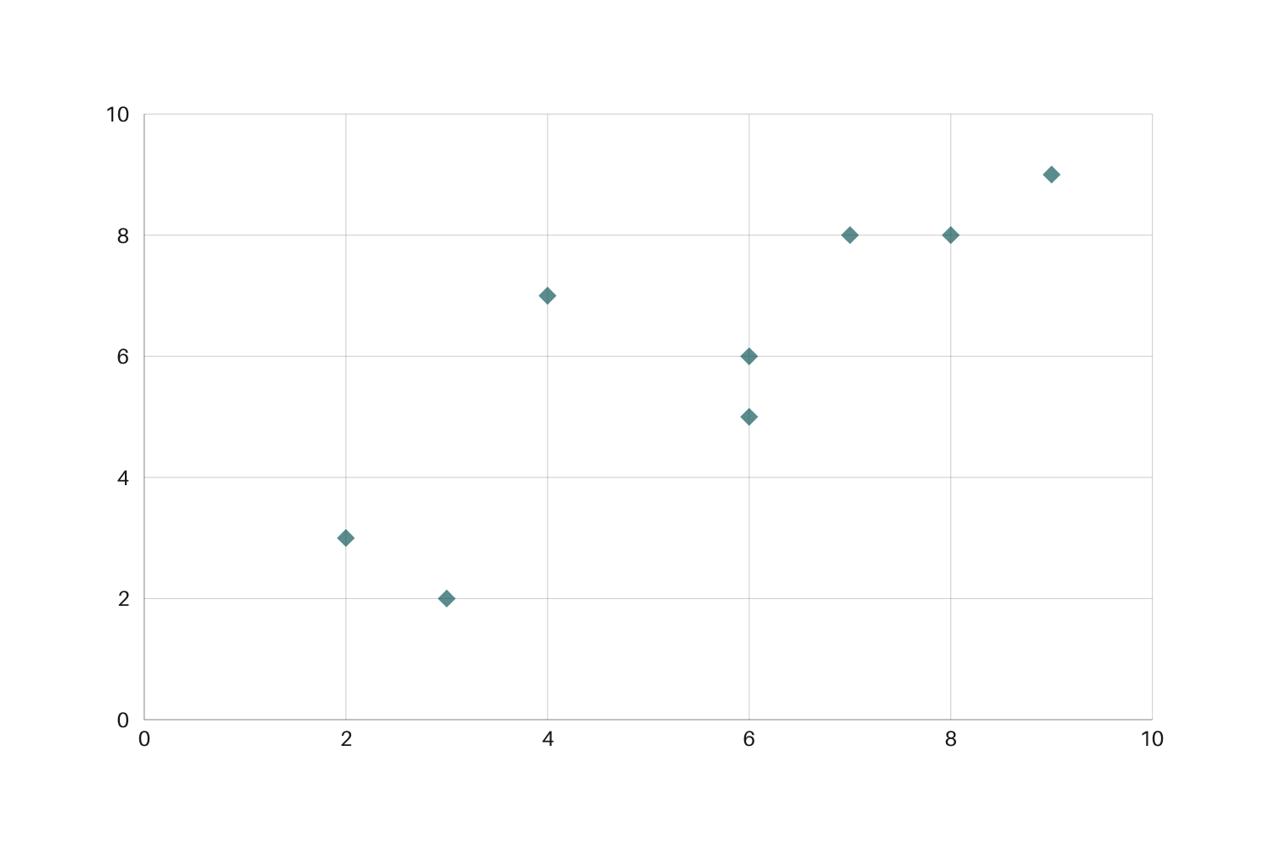
Stakeholder Interest - Influence Grid
Pratik Bedi (Project Sponsor)
Jibin K Sebastian (Project Manager)
Data Analysts Team
Keep
Satisfied
Policy Makers
Manage
Closely
IT Department
Municipal Housing
Department
City Planners
Level of Influence
Property Managers
Community Organizations
Monitor
(Minimal Effort)
Keep
Informed
Residents
Level of Interest

Slide 11
Initiation
Executing
Closing
Planning
Monitoring
Project Charter
Project Initiation
Team Management
Resource Allocation
Task Execution
Quality Assurance
Stakeholder Engagement
Deliverable Handover
Project Documentation
Team Release
Lessons Learned
Stakeholder Sign-off
Scope & Budget
WBS
Gantt Chart
Communication Plan
Risk Management
Performance Tracking
Progress Reporting
Change Management
Risk Monitoring
Issue Resolution

Slide 12







Quality Management
Cost Management
Resource Management
Planning
Schedule
Management
Communications
Management
Scope Management
Risk Management

Slide 13


Scope Management
Definition
Boundaries
Key Deliverables
Analyze Toronto apartment buildings using Evaluation dataset
Develop interactive visualizations of building conditions
Identify trends in maintenance and resident satisfaction
Provide actionable insights for stakeholders
Limited to residential apartment buildings in Toronto
Focused on data from 2023 onwards
Excludes commercial properties and single-family homes
Comprehensive data analysis report
Interactive Tableau dashboard
Stakeholder presentation of findings

Slide 14
WBS
Data Driven Evaluation of Toronto Apartment Buildings
Project
Initiation
Data Acquisition and Preparation
Data Analysis
Dashboard Development
Testing and Quality Assurance
Documentation
Deployment
Project Closure
Define project scope and objectives
Identify data
sources
Exploratory data analysis
Design dashboard layout
Develop test cases
Create user manual
Set up hosting environment
Conduct project
review
Identify
stakeholders
Access to Apartment Building Dataset
Statistical analysis
Create data visualizations
Perform functional testing
Develop technical documentation
Deploy dashboard
Gather feedback from stakeholders
Develop project
charter
Data cleaning and validation
Geospatial analysis
Implement interactive features
User acceptance testing
Prepare
data dictionary
Configure user access and security
Document lessons learned
Kick-off meeting
Data integration
Trend analysis
Develop filtering capabilities
Performance testing
Document analysis methodology
Perform final checks
Prepare final project report
Create derived variables
Correlation analysis
Integrate geospatial mapping
Bug fixing and refinement

Slide 15















Schedule Management
Data Collection & EDA
Testing and Refinement
Gather relevant datasets and identify patterns and insights
Oct 25, 2024
Validate functionality and user experience
Jan15, 2025
Project Initialization
Dashboard Development
Final Reporting
Define goals and scope
Sept 17, 2024
Present findings and insights
Feb 28, 2025
Create interactive visualizations and reports
Nov 30, 2024

Slide 16

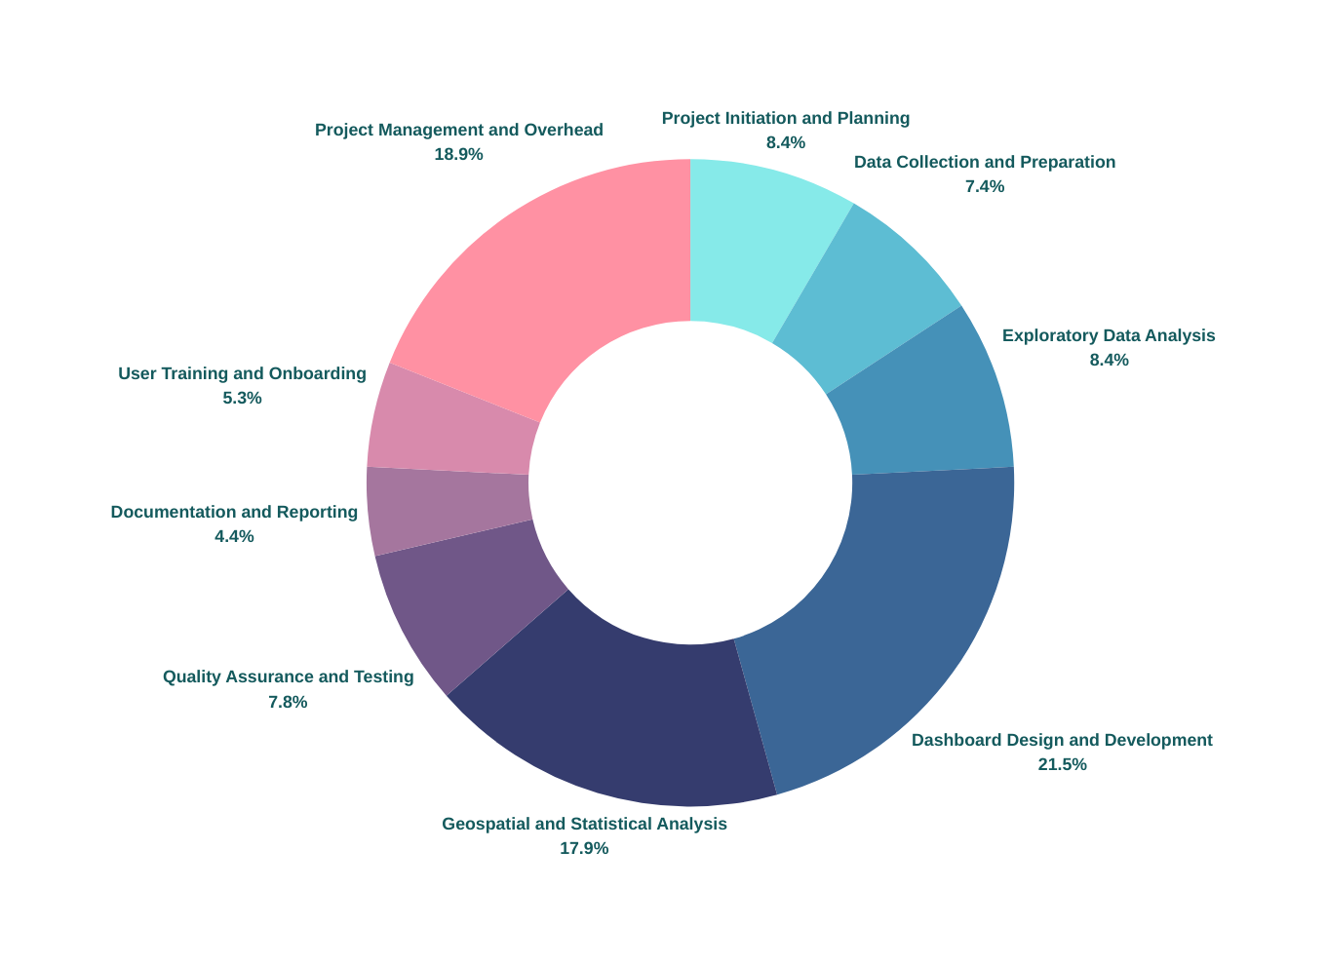
Cost Management
Project Initiation and Planning | $8,000
Data Collection and Preparation | $7,000
Exploratory Data Analysis | $8,000
Dashboard Design and Development | $20,400
Geospatial and Statistical Analysis | $17,000
Quality Assurance and Testing | $7,400
Documentation and Reporting | $4,200
User Training and Onboarding | $5,000
Project Management and Overhead | $18,000
$ 95,000

Slide 17
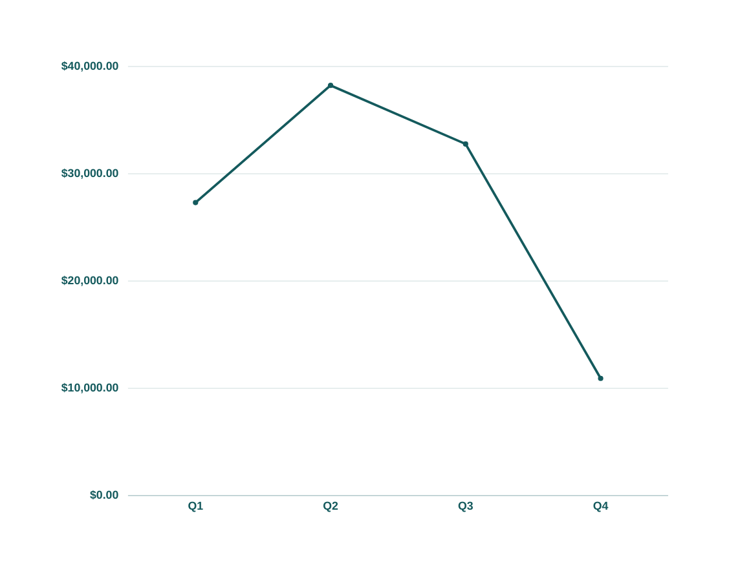
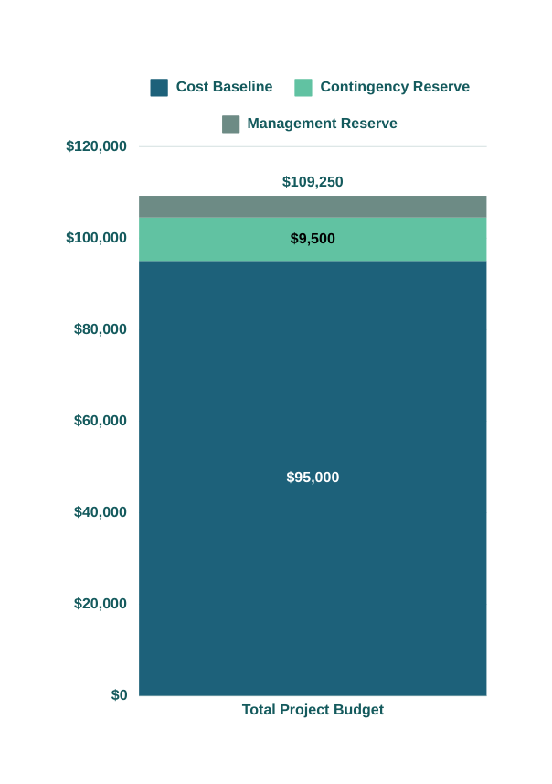
Budget Overview and Quarterly Allocation
$38,237.50
$32,775.00
$27,312.50
$10,925.00

Slide 18

Quality Management
Quality Standards Processes
Quality Assurance & Control
Data Accuracy
Dashboard Performance
User Experience
Analytical Precision
Automated Data Validation
Code Review
Testing
Documentation
Continuous Improvement

Slide 19

Resource Management
RESOURCE
WEEK 1-2
WEEK 3-4
WEEK 5-6
WEEK 7-8
WEEK 9-10
WEEK 11-12
Jibin Sebastian (Project Manager)
Project
Planning
Stakeholder Management
Progress
Monitoring
Risk
Management
Quality
Assurance
Final Review
Jibin George (Lead Analyst)
Requirements Gathering
Data Analysis
Plan
Statistical Model Design
Model
Development
Model Testing
Refinement
Vishal (Business Analyst)
Business Requirements
Data
Requirements
User Story
Creation
Dashboard Requirements
User Acceptance Testing
Documentation
Kailas (Technical Consultant)
Technical Architecture
Data
Integration
ETL Process
Data
Validation
Performance Optimization
Technical Documentation
Yashas (Tableau Specialist)
Dashboard
Planning
Data
Connection
Dashboard Prototyping
Visualization Development
Dashboard
Testing
Dashboard Refinement

Slide 20
RACI Matrix
TASK
JIBIN SEBASTIAN
JIBIN GEORGE
KAILAS KRISHNAN
VISHAL RAMESH
YASHAS MS
Project Initiation and Planning
A
I
I
R
C
R : Responsible
A : Accountable
C : Consult
I : Inform
Data Collection and Preparation
C
I
A/R
I
I
Exploratory Data Analysis
C
R
A
I
I
Analysis Code Development
A
R
C
I
I
Geospatial Analysis
C
A/R
C
I
I
Dashboard
Design
C
A/R
C
I
R
Documentation and Reporting
C
I
I
A/R
C
Stakeholder Communication
A
I
I
C
R
Quality Assurance and Testing
A
R
C
I
I
Lessons
Learned
C
A/R
C
C
C
Project
Closure
A
C
C
C
C

Slide 21

Communications Management
Communication Plan
Stakeholder Engagement Strategies
Regular updates: Weekly team meetings, monthly stakeholder updates
Channels: Emails, project management software, dedicated engagement platform
Tailored messaging for different stakeholder groups
Feedback mechanisms: Surveys, focus groups, online forms
Early and continuous engagement
Prioritize stakeholders
Active listening and feedback incorporation
Relationship building
Continuous Improvement

Slide 22


Risk Management
Stage 1
01
02
Stage 2
Identify Risk
Plan Risk Responses
Stage 4
04
03
Stage 3
Monitor Risks Process
Implement Risk Responses

Slide 23
Risk Management
Risk Identification Process
Risk Mitigation Strategies
Create systematic approach
Gather information from various sources
Apply identification techniques:
Brainstorming
SWOT analysis
Root cause analysis
Document risks in risk register
Assess process effectiveness
Risk Avoidance
Risk Transfer
Risk Reduction
Implement preventive measures
Develop contingency plans
Risk Acceptance
Monitor low-impact risks

Slide 24
Initiation
Executing
Closing
Planning
Monitoring
Project Charter
Project Initiation
Team Management
Resource Allocation
Task Execution
Quality Assurance
Stakeholder Engagement
Deliverable Handover
Project Documentation
Team Release
Lessons Learned
Stakeholder Sign-off
Scope & Budget
WBS
Gantt Chart
Communication Plan
Risk Management
Performance Tracking
Progress Reporting
Change Management
Risk Monitoring
Issue Resolution

Slide 25
Execution
Initiation of the Project
Setting Direction
Monitoring Progress
Stakeholder Engagement
Mobilize the team and allocate resources as per the project plan.
Implement the project plan while ensuring alignment with strategic goals.
Regularly check project status against the plan, making adjustments as necessary.
Maintain clear communication and involvement of stakeholders throughout the execution phase.

Slide 26






Managing Project Work
Managing Project Activities
Adaptive Management
Implementing Project
Plan
Daily stand-up meetings to discuss progress and obstacles
Weekly progress reviews against project timeline
Adjust resource allocation as needed
Regular risk assessments
Implement change control processes
Continuous improvement based on lessons learned
Key Tools
Follow the Work Breakdown Structure (WBS)
Assign tasks based on team members' skills and availability
Use project management software for task tracking
Gantt charts for timeline visualization
Kanban boards for task management
Time tracking software for resource management

Slide 27










Managing Quality
Quality Standards
Quality Assurance Processes
Quality Control Measures
Continuous Improvement
Adhere to data accuracy benchmarks (99.9%)
Ensure dashboard performance meets load time criteria (<3 seconds)
Comply with accessibility standards (WCAG 2.1 AA)
Regular code reviews and peer evaluations
Automated testing for data processing and visualizations
User acceptance testing for dashboard functionality
Implement checkpoints at key project milestones
Conduct data audits to verify accuracy and completeness
Perform usability testing with target user groups
Gather and analyze user feedback
Implement iterative improvements based on insights
Document best practices and lessons learned

Slide 28








Managing Communication
Progress Reporting
Feedback Mechanisms
Bi-weekly status reports to key stakeholders
Monthly executive summaries to leadership
Quarterly comprehensive project reviews
Regular surveys to assess communication effectiveness
Open forums for Q&A sessions
Dedicated feedback channels for continuous improvement
Communication Channels
Communication Tools
Weekly email updates to all stakeholders
Monthly virtual town halls for broader updates
Dedicated project portal for real-time status updates
Project management software for internal team updates
Video conferencing for virtual meetings
Interactive dashboards for real-time project metrics

Slide 29






Stakeholder Engagement
Engagement Strategies
Addressing Concerns
Tailored engagement plans for different stakeholder groups
Regular check-ins with key influencers and decision-makers
Involvement in key project milestones and decision points
Proactive identification of potential issues
Open door policy for stakeholder concerns
Timely response and resolution tracking
Collaborative Activities
Measuring Engagement
Workshops for requirements gathering and validation
Focus groups for user experience feedback
Beta testing programs for early adopters
Track stakeholder participation rates
Monitor feedback sentiment and trends
Assess impact of stakeholder input on project outcomes

Slide 30
Initiation
Executing
Closing
Planning
Monitoring
Project Charter
Project Initiation
Team Management
Resource Allocation
Task Execution
Quality Assurance
Stakeholder Engagement
Deliverable Handover
Project Documentation
Team Release
Lessons Learned
Stakeholder Sign-off
Scope & Budget
WBS
Gantt Chart
Communication Plan
Risk Management
Performance Tracking
Progress Reporting
Change Management
Risk Monitoring
Issue Resolution

Slide 31
Monitoring
01
Progress Tracking
06
02
Quality Control Checks
Performance Measurement
05
03
Change Control Management
Risk Assessment
04
Stakeholder Communication

Slide 32
Performance Metrics
Planned Value (PV) & Actual Cost (AC)
Cost Variance (CV)
$ 65,550 & $ 60,400
- $ 312.50
We're at the end of Q2 (50% of project duration):
PV = 60% of budget (Q1 + Q2) = $65,550
The actual cost at this point is $60,400
CV = EV - AC
CV = $60,087.50 - $60,400 = -$312.50
Earned Value (EV)
Schedule Performance Index (SPI)
$ 60,087.50
0.92
Almost 55% of work is completed:
EV = 55% of $109,250 = $60,087.50
SPI = EV / PV
SPI = $60,087.50 / $65,550 = 0.92
SPI < 1 indicate that the project is slightly behind schedule
Schedule Variance (SV)
Cost Performance Index (CPI)
- $ 5,462.50
0.99
SV = EV - PV
SV = $60,087.50 - $65,550 = -$5,462.50
CPI = EV / AC
CPI = $60,087.50 / $60,400 = 0.99
CPI < 1indicate that the project is slightly over budget

Slide 33







Change Management
Develop and implement a statistical model to determine the key factors influencing building evaluation scores in the Toronto Apartment Building Evaluation dataset. This model will analyze various building characteristics and their correlation with evaluation scores. (Proposed by Jibin George, Lead Analyst)
Scope
The project scope will expand to include advanced statistical analysis and modeling, requiring additional time and resources
Cost
Potential costs for additional software licenses or cloud computing resources for data processing and analysis
Quality
This change will significantly enhance the quality and depth of insights provided by the project
Schedule
Estimated 2-3 weeks additional time required for model development, testing, and integration into the dashboard
Requirements
Additional data processing and statistical analysis tools may be required. Team members might need training in advanced statistical methods
Stakeholder Impact
Stakeholders will gain more valuable insights, enabling better decision-making for urban planning and building management

Slide 34




Quality Management
Regular Code Reviews
Data Validation Checks
Peer evaluations of analysis scripts
Adherence to coding standards
Automated checks for data accuracy
Consistency verification across datasets
Automated Testing
User Acceptance Testing
Unit tests for key functions
Integration tests for dashboard components
Stakeholder involvement in testing
Usability assessments with target users

Slide 35
Initiation
Executing
Closing
Planning
Monitoring
Project Charter
Project Initiation
Team Management
Resource Allocation
Task Execution
Quality Assurance
Stakeholder Engagement
Deliverable Handover
Project Documentation
Team Release
Lessons Learned
Stakeholder Sign-off
Scope & Budget
WBS
Gantt Chart
Communication Plan
Risk Management
Performance Tracking
Progress Reporting
Change Management
Risk Monitoring
Issue Resolution

Slide 36
Project Closure
Project Closure Activities
Importance of Proper Project Closure
Final Deliverable Submission
Stakeholder Acceptance
Financial Closure
Documentation and Archiving
Lessons Learned
Knowledge Capture
Organizational Learning
Stakeholder Satisfaction
Resource Optimization
Continuous Improvement

Slide 37




Lessons Learned
01
02
03
04
Requirements Definition and Management
Scope Definition and Management
Schedule Development and Control
Cost Estimating and Control
What Worked Well
Comprehensive stakeholder engagement led to clear requirements
What Can Be Improved
More frequent requirement reviews could have caught changing needs earlier
What Worked Well
Clear project objectives helped maintain focus
What Can Be Improved
More detailed scope breakdown could have improved task allocation and estimation
What Worked Well
Agile sprints allowed for flexible development
What Can Be Improved
Better estimation of data cleaning time required
What Worked Well
Budget allocation for Tableau licenses was accurate
What Can Be Improved
Better estimation of data cleaning time required

Slide 38



Lessons Learned
05
06
07
08
Quality Planning and Control
Human Resource Availability, Team Development, and Performance
Communication Management
Stakeholder Management
What Worked Well
Regular data quality checks ensured accuracy
What Can Be Improved
Need for more automated testing of dashboard functionality
What Worked Well
Cross-functional team collaboration was effective
What Can Be Improved
More training on geospatial data handling would have been beneficial
What Worked Well
Weekly status updates kept stakeholders informed
What Can Be Improved
Improve communication with external data providers
What Worked Well
Early involvement of end-users in design process
What Can Be Improved
More frequent demos to city officials could have improved buy-in

Slide 39



Lessons Learned
09
10
11
12
Reporting
Risk Management
Procurement Planning and Management
Process Improvement Information
What Worked Well
Automated report generation saved time
What Can Be Improved
Standardize report formats across different user groups
What Worked Well
Regular risk assessments helped mitigate issues
What Can Be Improved
Develop more detailed contingency plans for data inconsistencies
What Worked Well
Successful negotiation of Tableau enterprise license
What Can Be Improved
Earlier engagement with IT for server provisioning
What Worked Well
Iterative dashboard development improved efficiency
What Can Be Improved
Standardize data cleaning processes for future updates

Slide 40
Conclusion
Our project on apartment building standards has successfully concluded, delivering valuable insights and establishing a robust framework for future initiatives. Key outcomes include:
Data-Driven Standards
Performance Metrics
Comprehensive analysis of apartment building conditions
Identified critical areas for improvement in building design
Utilized Earned Value Management techniques
Monitored project progress using SPI and CPI
Our approach is built on a foundation of innovation, collaboration, and unwavering commitment to excellence. This project has not only achieved its objectives but also:
Enhanced apartment building standards
Provided a model for future data-driven projects
Contributed to organizational learning and best practices
Moving forward, we will leverage these insights to drive further success and innovation in urban development and project management.

Slide 41

References
https://open.toronto.ca/dataset/apartment-building-evaluation/
https://open.toronto.ca/dataset/upcoming-and-recently-completed-affordable-housing-units/
https://www.toronto.ca/services-payments/building-construction/
https://www.toronto.ca/services-payments/venues-facilities-bookings/
https://www.toronto.ca/community-people/housing-shelter/rental-housing-tenant-information/rental-housing-standards/apartment-building-standards/rentsafeto-for-building-owners/

Slide 42





Thank You
We look forward to the journey ahead, where we can turn our shared vision into reality.

